Slide 1
CDS Graduate Student Analysis and Visualization(Group11)
Yoontae Park(yp2201)
Yoobin Cheong(yc5206)
Ilias Arvanitakis(ia2248)
Joseph Schuman(js12580)

Slide 2
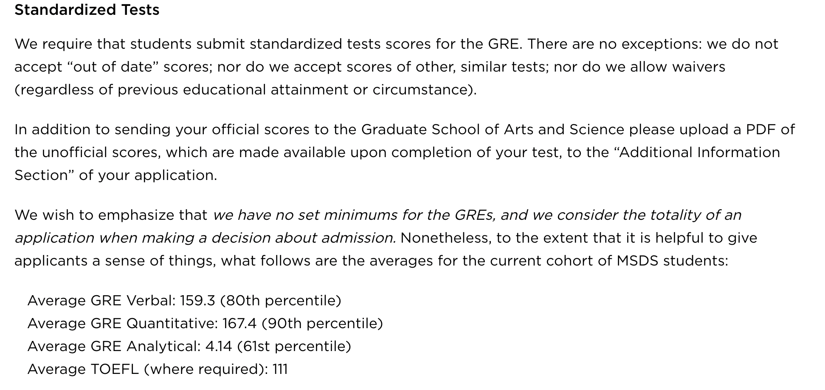
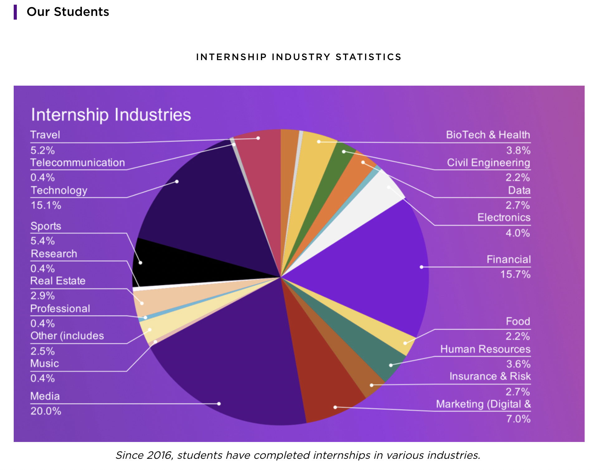
CDS Graduate Student Analysis and Visualization(Group11)
• Objective
- To get an intuition of CDS students(Current/Past)
- Providing analysis and visualization report to CDS faculty
→ Help CDS to get a better visualization results for students
[CDS webpage(Student background]
[CDS webpage(Career Outcome]

Slide 3
CDS Graduate Student Analysis and Visualization(Group11)
• Why working on visualization project?
- Visualization is one of the most important skills for Data Scientists
[Data Scientist Skills]
[Visualization as important skills for DS]

Slide 4
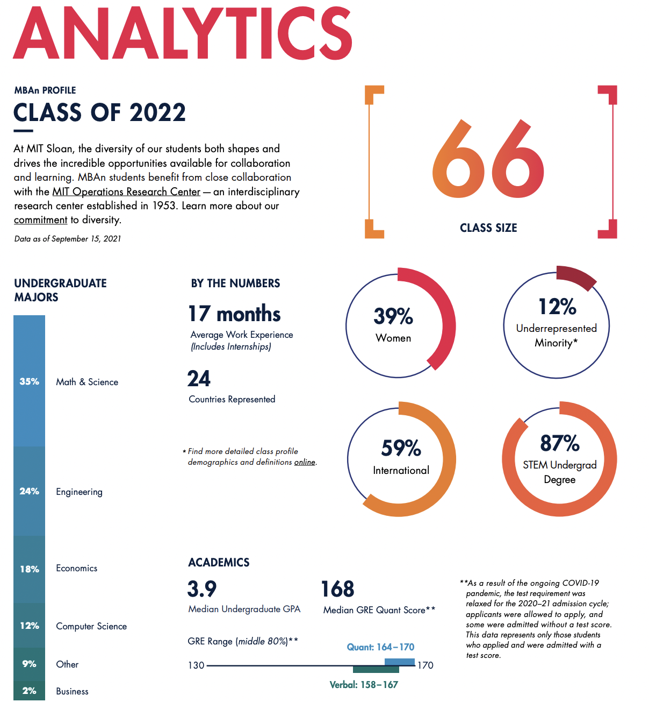
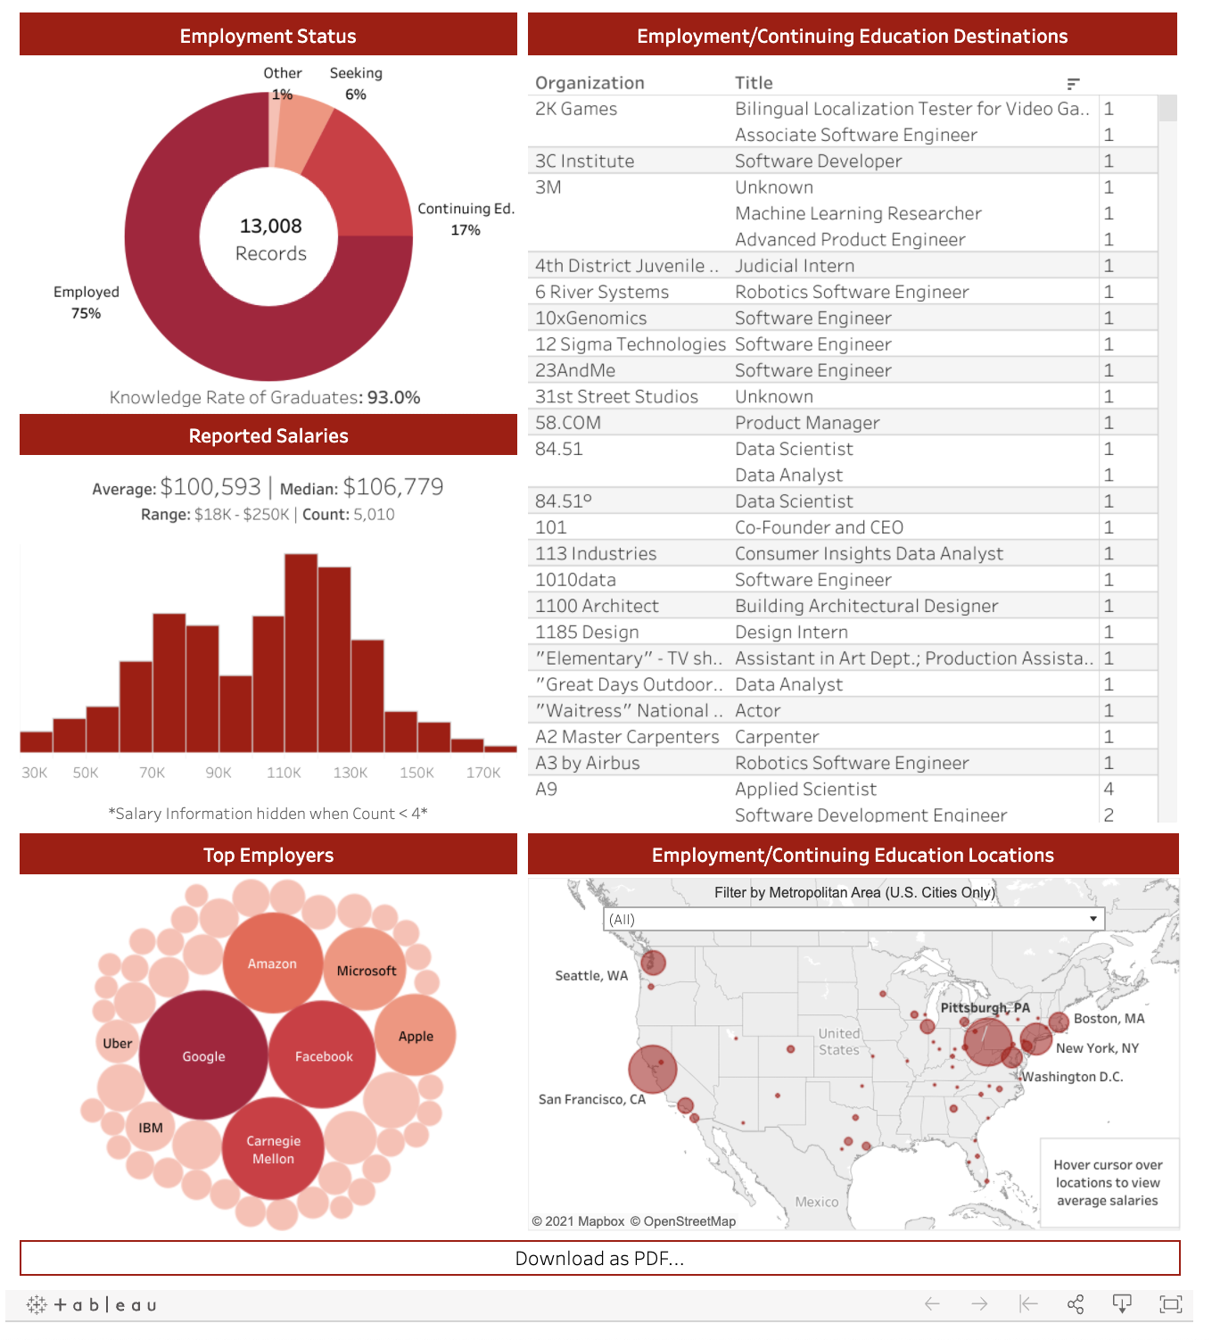
CDS Graduate Student Analysis and Visualization(Group11)
• Draft of final report: Class analysis and visualization report
[Draft of final report(Class analysis)
[Draft of final report(Career outcome]

Slide 5
CDS Graduate Student Analysis and Visualization(Group11)
• What kind of data do we have
- Student background information: Legal sex, US citizenship, GPA, GRE
- Student professional outcome: Summer internship outcome, Career outcome
[Anonymous Student data]
For illustrative purposes only
Not representative of actual data

Slide 6
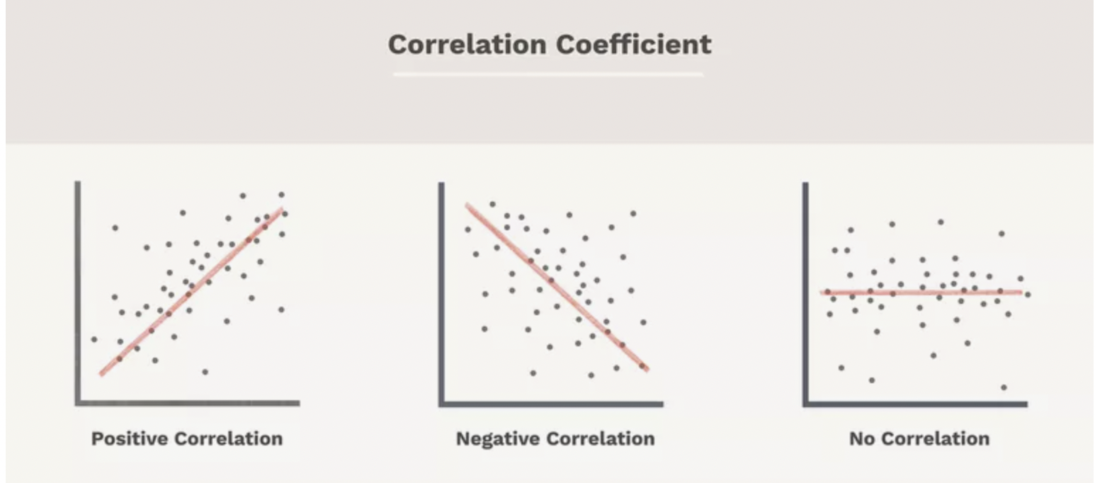
CDS Graduate Student Analysis and Visualization(Group11)
• What to do with these dataset
- Data analysis: Knowing correlations between student features
- Visualization: Distribution of students by visualizing mean/min/max values of data
[Correlation between features]
[Visualization as important skills for DS]
 | GPA | GRE | …
count | /// | /// | ///
mean | /// | /// | ///
std | /// | /// | ///
min | /// | /// | ///
25% | /// | /// | ///
50% | /// | /// | ///
75% | /// | /// | ///
max | /// | /// | ///

Slide 7
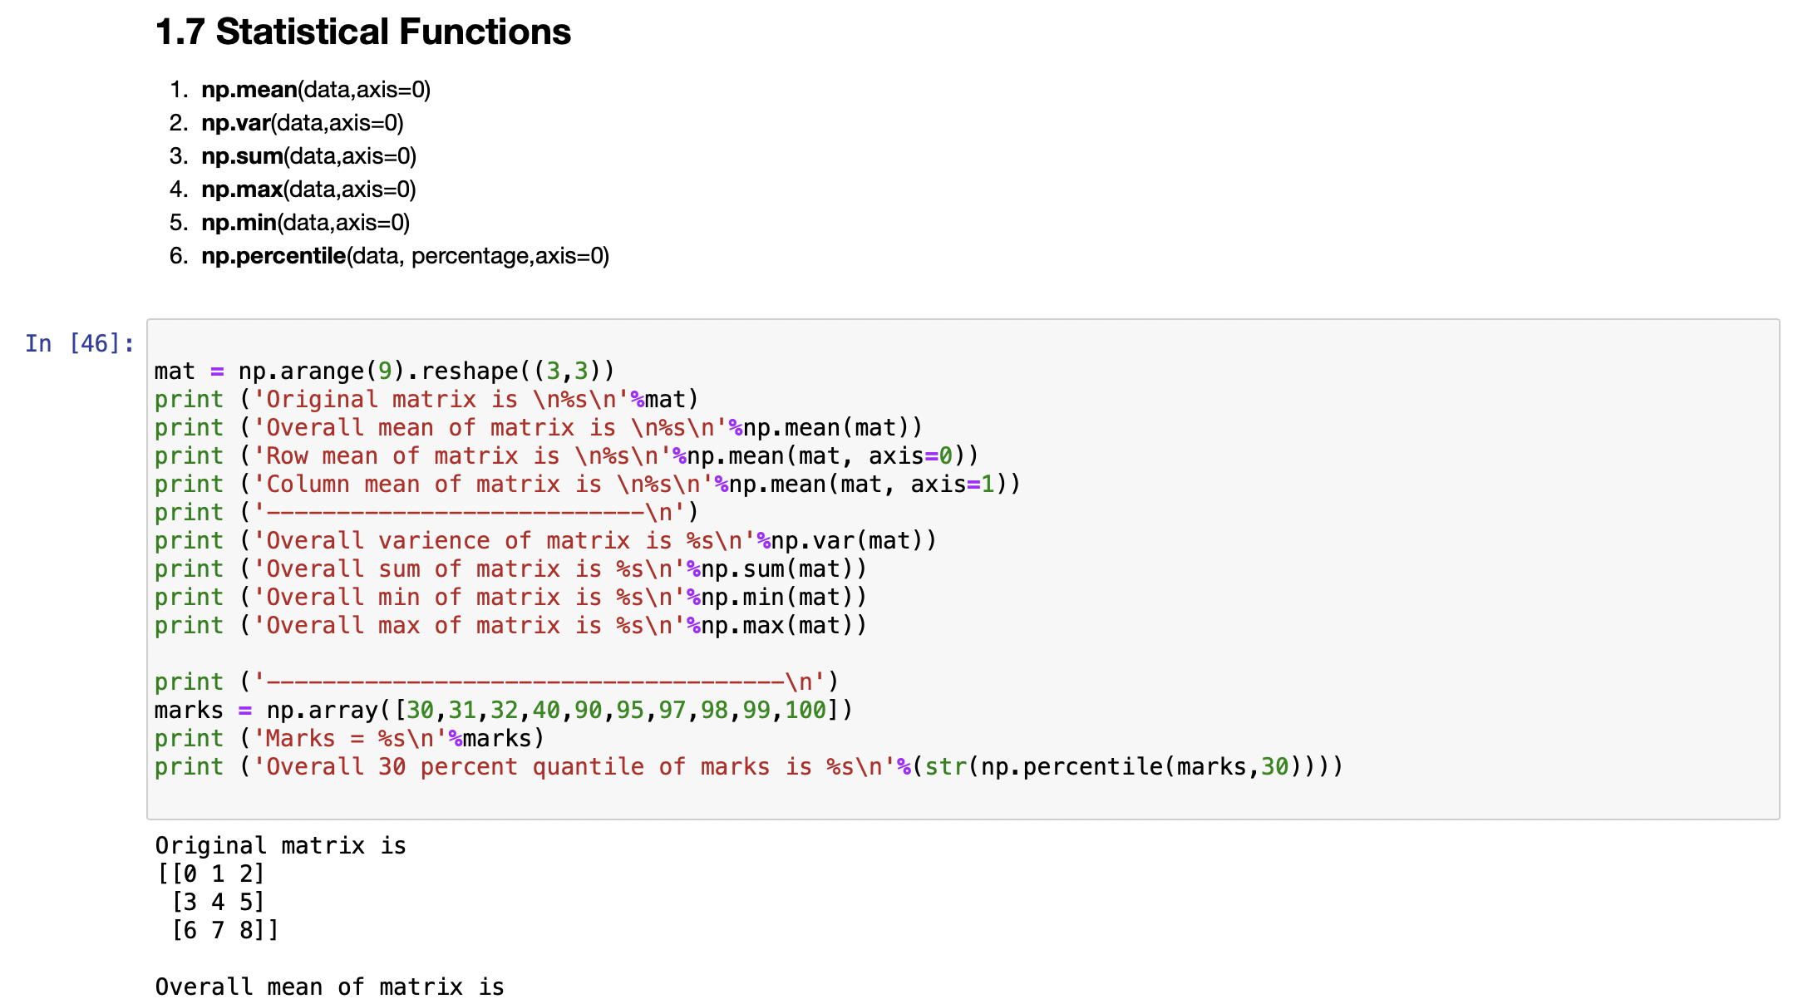
CDS Graduate Student Analysis and Visualization(Group11)
• How to get those results
- Getting basic statistics by using functions that we’ve learned in class(i.e. numpy)
- Trying some regression methods and figure out correlations between columns
- Using visualization tools such as Tableau, MS Power BI, etc
[Numpy Functions]
[Pandas / Tableau]

Slide 8
CDS Graduate Student Analysis and Visualization(Group11)
• Sources
- CDS faculty anonymous student dataset(data that cannot distinguish students)
- Linkedin profile of NYU MSDS graduate students
- NYU websites(i.e. CDS webpage, Career website)
- Reference websites(MIT sloan student analytics report, CMU career website)

